Slide 1
T02 nocLock
Trampus, Jaimus, Shampus, Cameronmpus

Slide 2
Overview of Presentation
Problem/need
Design
etc

Slide 3
Problem
Create an interesting alternative to traditional locking methods. < Wording will change>
Novelty device that is cool.
Most likely put in proposal or whatever the ambiguous statement is.

Slide 4
Objectives
Work as a team to design, construct, and demonstrate a small project.

Slide 5
Requirements
Device must lock and unlock.
Device must differentiate between many distinct knock sequences.
Device must be reliable. (i.e. stay locked/unlocked when expected)
Device should be user friendly and intuitive.
Device must be safe to operate.
Device must be affordable.
Device must be durable.

Slide 6
Approach/Overview of Project
Made decisions as a group using decision tables with weighted votes for team members. <prob not use this>
Broke team into two main groups, usually had one partner tackle initial design and one partner verify and help debug design.

Slide 7
Design
Top down design based off of Use-Case diagram.
Created block diagram which helped to isolate different subsystems.
Designed with a modular approach by designing each subsystem separately.

Slide 8
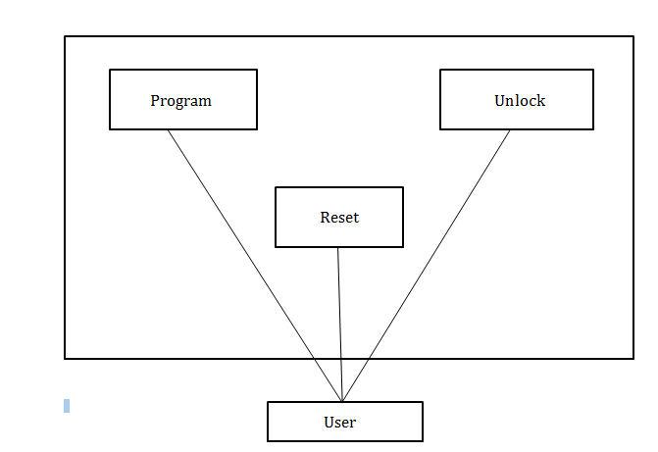
Use-Case Map

Slide 9
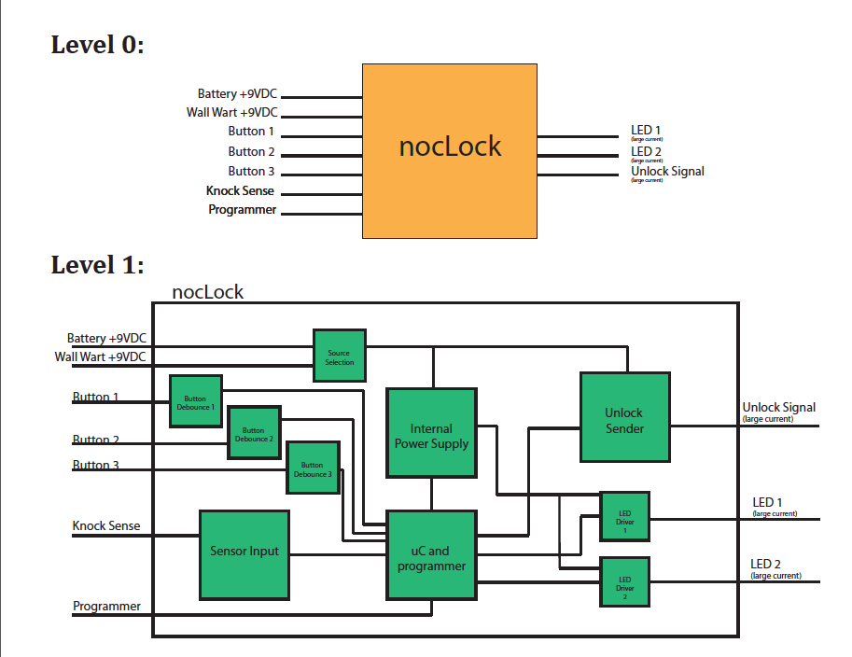
Block Diagram

Slide 10
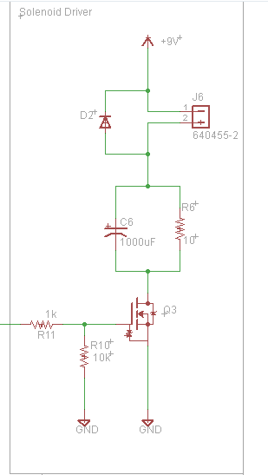
Solenoid Subsystem
Overall Design
Key Parameters inputs outputs etc.
Integrates with following sub systems: Microcontroller, etc.
Alternatives: Darlington Pair, Charge Pump.

Slide 11
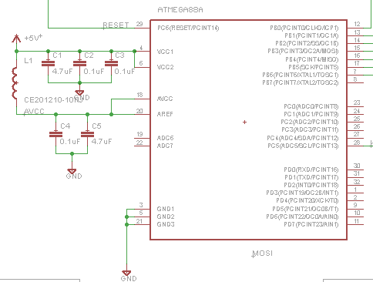
Microcontroller Subsystem
Overall Design
Key Parameters inputs outputs etc.
Central Hub integrates with all sub systems.
Alternatives: Chose this one because we had one, and costs, performance.

Slide 12
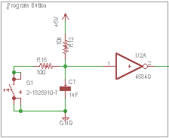
Button System
Overall Design
Key Parameters inputs outputs etc.
Integrates with following sub systems: Microcontroller, etc.
Alternatives: Darlington Pair, Charge Pump.

Slide 13
LED Driver Subsystem
Overall Design
Key Parameters inputs outputs etc.
Integrates with following sub systems: Microcontroller, etc.
Alternatives: Darlington Pair, Charge Pump.

Slide 14
Knock Sense Subsystem
Overall Design
Key Parameters inputs outputs etc.
Integrates with following sub systems: Microcontroller, etc.
Alternatives: Darlington Pair, Charge Pump.

Slide 15
Software

Slide 16
Testing
Testing started with modular testing. This was done to verify design and helped to find bugs in an easier to debug isolated system.
LED’s were used as stubs in order to integrate the hardware with the software and step through the code.

Slide 17
Major Setbacks/Bugs
Button Debounce
CPU clock speed
Program Mode
Knock Sense threshold <voltage>
Knock Sense Delay <time>

